Slide 1
Bangalore House Price Prediction Machine Learning Based Real Estate Price Estimation System
Problem Statement
House prices in Bangalore vary significantly depending on:
Location, Property, Size, BHK Count, Area Type, Amenities.
Manual estimation is difficult and may lead to inaccurate pricing decisions.
Proposed Solution
Developed an intelligent ML-based system that:
Analyzes housing data
Learns pricing patterns
Predicts estimated house prices instantly
Dataset
13,000+ Property Records
9 Features

Slide 2
Data Preprocessing & EDA
Data Preprocessing
Steps Performed
Removed missing values
Cleaned total_sqft values
Extracted BHK information
Removed outliers
Handled rare locations
Applied One Hot Encoding
Exploratory Data Analysis (EDA)
Visualizations Used
Price Distribution
Top Locations Analysis
BHK Distribution
Correlation Heatmap
Price vs Sqft Analysis
Key Insights
Location highly impacts house price
Larger sqft increases property value
BHK and bathrooms strongly influence pricing
Outlier removal improved prediction accuracy

Slide 3
EDA & Model Training
Machine Learning Models Used
Evaluation Metrics
R² Score
MAE
RMSE
Best Performing Model
Random Forest Regressor — 95.21% Accuracy
Why Random Forest?
Handles complex data patterns
Reduces overfitting
Provides stable and accurate predictions
Model | Accuracy
Linear Regression | 84.23%
Decision Tree Regressor | 89.92%
Random Forest Regressor | 95.21%

Slide 4
Streamlit Deployment
Streamlit Web Application
User Inputs
Location Dropdown
Area Type Dropdown
Total Sqft
BHK
Bathrooms
Balconies
Output
Estimated House Price Prediction is ₹ 112 Lakhs.

Slide 5
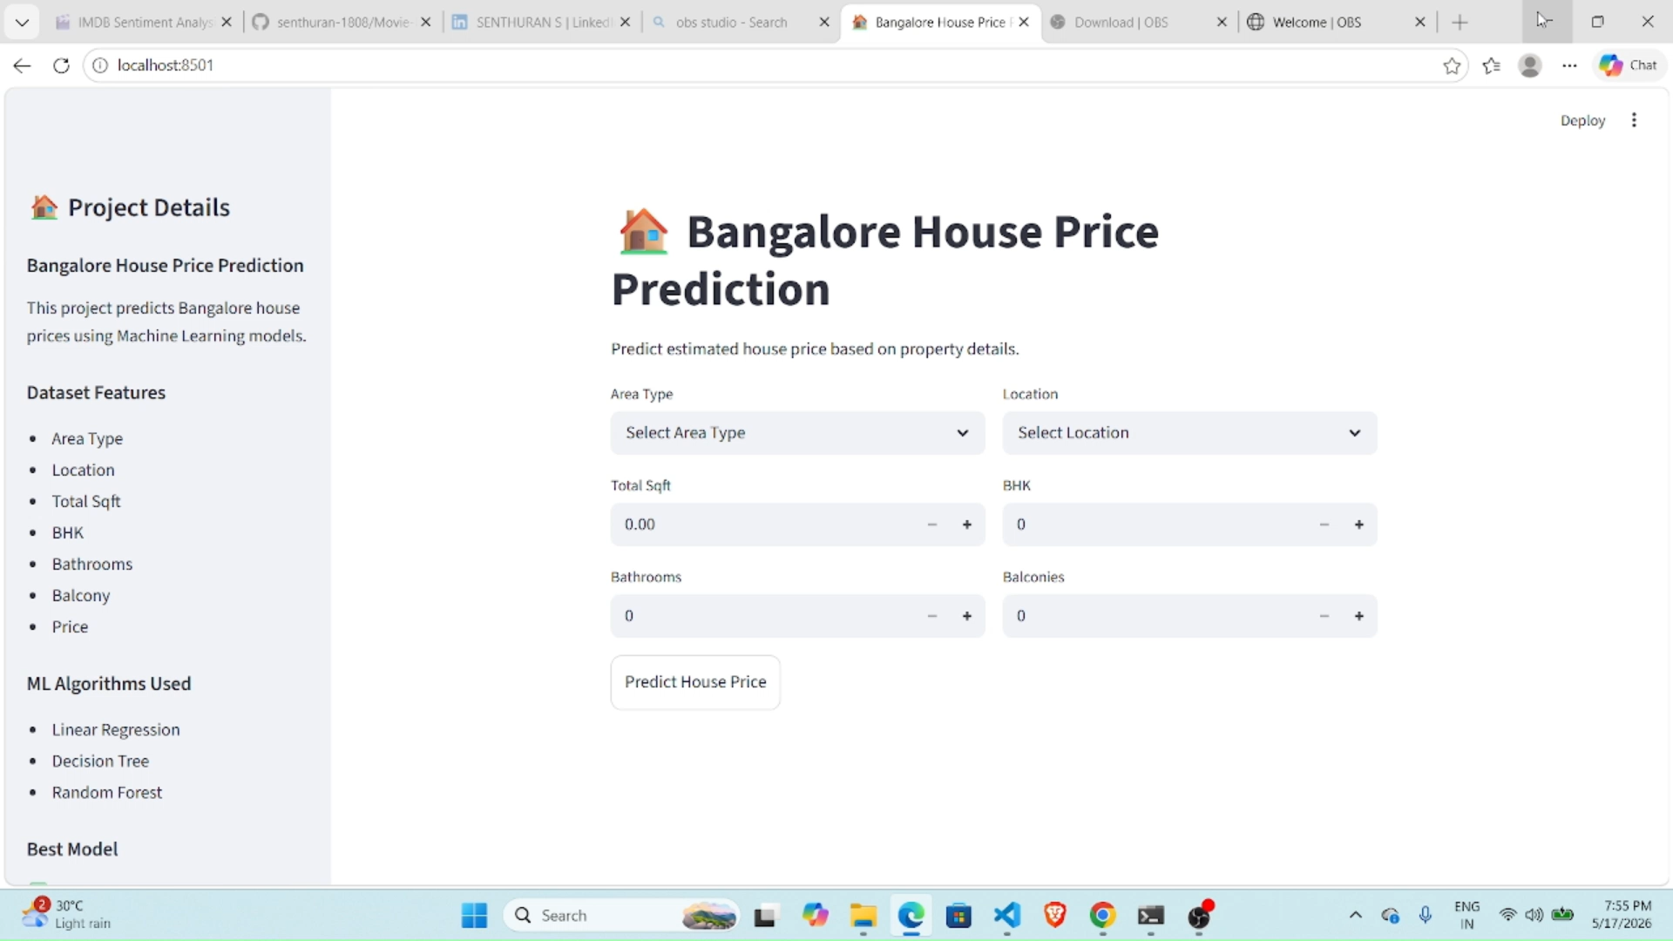
Demo Video

Slide 6
Conclusion
The application predicts Bangalore house prices accurately and helps users make informed real-estate decisions using Machine Learning.
This project successfully demonstrates:
Data Cleaning & EDA
Feature Engineering
Machine Learning Model Training
Model Evaluation
Streamlit Deployment

